Slide 1
CS5551 Advanced Software Engineering Design Patterns: Interpreter Pattern
By
Muktevi, Vamsi Krishna
Tummala, Vijay Kumar
Panja, Gopal
Murakonda, Sravani

Slide 2
Interpreter Pattern
The main intent of Interpreter pattern is to map a domain to a language, the language to a grammar, and the grammar to a hierarchical object oriented design.
Each given expression is interpreted and some conditions are validated and a Boolean output is produced for each interpreted expressions.
The client provides the String (Context) that is to be interpreted.
Some validations are performed by the interpreter on the given context and a Boolean output is generated by the interpreter.

Slide 3
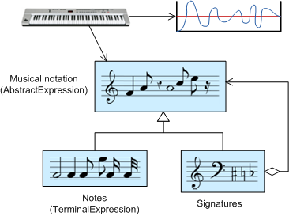
Interpreter Pattern

Slide 4
Interpreter Pattern
The Interpreter pattern has a limited area where it can be applied.
It can be only discussed in terms of formal grammar but in this area there are better solutions.
This is the reason why this pattern is not so frequently used.
This pattern can be applied for parsing light expressions defined in simple grammars.

Slide 5
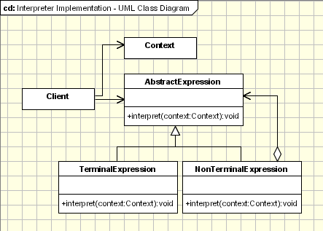
Interpreter Pattern
The implementation of Interpreter Patten is just the use of composite pattern to represent grammar.
The interpreter defines the behavior while composite defines the structure.
http://www.oodesign.com/images/behavioral/interpreter-pattern.gif

Slide 6
Interpreter Pattern
Expression.java
TerminalExpression.java
OrExpression.java
AndExpression.java
Client.java

Slide 7
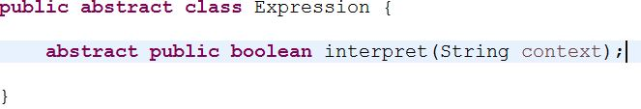
Interpreter Pattern
Expression.java

Slide 8
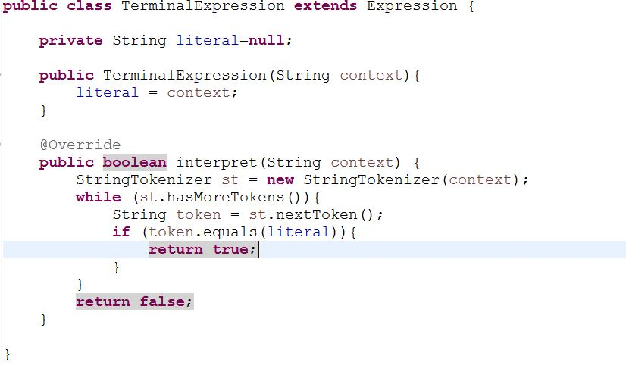
Interpreter Pattern
TerminalExpression.java

Slide 9
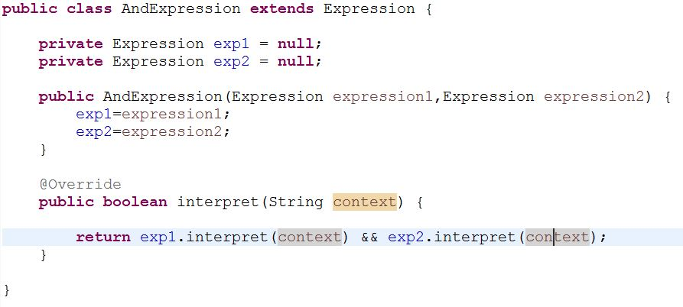
Interpreter Pattern
AndExpression.java

Slide 10
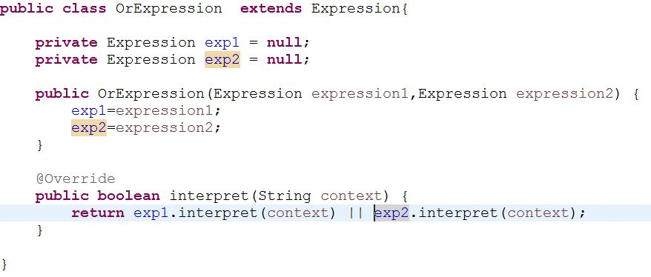
Interpreter pattern
OrExpression.java

Slide 11
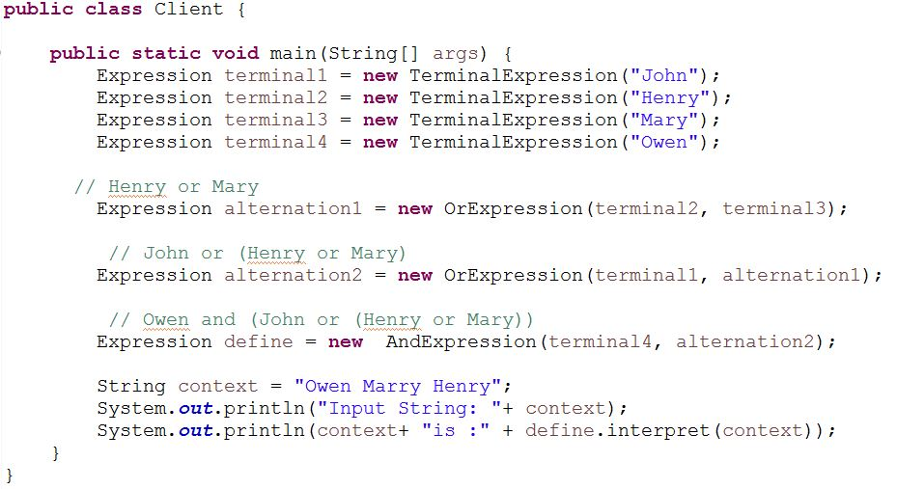
Interpreter pattern
Client.java

Slide 12
Interpreter Pattern
Input & output

Slide 13
References
http://www.oodesign.com/interpreter-pattern.html
http://www.tutorialspoint.com/design_pattern/interpreter_pattern.htm
https://en.wikipedia.org/wiki/Interpreter_pattern
https://sourcemaking.com/files/sm/images/patterns/Interpreter_example1.png

